Slide 1

4th Annual
Antelope Valley
STEMposium
November 6th, 2015
Lancaster, CA

Slide 2
4th Annual AV STEMposium
7:30--8:20 am-----Registration/Breakfast
8:20---8:30 am-----Call to Order-Kimberly Maevers, President, GAVEA
Vicki Medina, Executive Director, AVBOT
8:30--8:40 am-----Welcome Remarks—Ed Knudson, President AVC
8:40—9:10 am-----Director’s Update---Christos Valiotis, AVC
9:10---9:30 am-----CSULB AV Engineering Program Update---Ken Santarelli, CSULB
9:30---9:55 am-----California Science Learning Network- AV-East Kern Update
9:55---10:10 am-----Break
10:10---10:40 am-----Science Education for 21st Century Skills---Wes Farno, 29:11 Strategies
10:45---11:15 am-----NASA Undergraduate Research Initiative, Al Bowers, Chief Scientist, NASA Armstrong
Send an Email now to
hsistemcoop@gmail.com
…and you will receive a link to all the documents for this event.

Slide 3
AVC-CSULB-Cerro Coso
STEM Collaborative
Christos Valiotis
Antelope Valley College
Physics Professor
Chair, Physical Sciences Department
Director, STEM-HSI program
4th Annual STEMposium Nov. 6th, 2015

Slide 4
Our Past…Foundational Efforts 1999-2006
Creation of the Mathematics-Science-Engineering-Technology (MSET) Consortium--1999
Initial Effort to Establish a Local Engineering Program thru CSU Fresno--2000-2004
AVC redesigns existing Math, Physics, Chemistry courses to incorporate Hands-On, Inquiry-Based Learning methods—2001-2004
AVC offers annual Summer Training Academies for K-12 STEM teachers –2004-2006
Notes:
AFRL, City of Lancaster provided initial funding for the establishment of the Lancaster University Center.

Slide 5
Our Past… Outputs/Outcomes 1999-2006
MSET partners meet regularly to:
  Promote STEM awareness
  Create a robust STEM pathway from K-12 to AVC to Local Engineering Program
  Identify needs and resources
  Assist in developing STEM academies in K-12
First Engineering classes are offered at Lancaster University Center (LUC)
48 K-8 math teachers and 32 Science K-8 teachers participate in the AVC Summer Training Academies (Funded by NSF)
Notes:
Boeing contributed about $350K in school grants for equipment

Slide 6
Our Past… Outputs/Outcomes 1999-2006, cont…
AVC receives an honorable mention at the 2006 Phi Theta Kappa (National Honor Society) conference, for its teacher preparation program.
However, in 2000-2001….
There were ONLY 35 declared engineering majors at AVC.
…and,
a little over 300 students enrolled in advanced Math, Physics, and Engineering courses.
….the STEM pipeline flow was barely a trickle!!!

Slide 7
Our Past… Struggling to Sustain the STEM Pathway
2006-2011
In 2006, AVC is awarded a 5 year/$3 million grant to increase and sustain the STEM pathway to CSU Bakersfield and CSU Fresno local engineering program.
By 2011, there are 135 identified engineering majors at AVC, and approximately 600 students enrolled in advanced Math, Physics, and Engineering courses.
14 students graduate with engineering degrees from CSU Fresno in 2009 (last year of the program).
AVUHSD introduces the first Project Lead the Way (PLTW) programs in 2008

Slide 8
Our Past… Struggling to Sustain the STEM Pathway
2006-2011
In 2010, 27 out 29 PLTW students graduating from Highland High, are accepted in the Cal Poly SLO engineering program!!!!!
After 2008, the efforts are starting to falter due to severe cuts on state funding.
Enrollments at AVC are stagnant and are maintained only thru federal grant money.
There is no funding available to continue the Summer Academies for Teachers.

Slide 9
Our Present…Light at the End of the Tunnel…finally! 2011-2015
The PLTW effort is expanded significantly at the AVUHSD to include 5 high schools and courses are articulated with AVC.
There are 14 STEM related academies at AVUHSD schools with over 9000 students participating.
See folder for details!

Slide 10
Our Present…Light at the End of the Tunnel…finally! 2011-2015
AVC wins two federal STEM grants totaling $11 million.
Course offerings in Physics, Chemistry, Math, and Engineering double.
By 2015 , there are 435 declared majors in engineering at AVC.
Over 1200 unique students are enrolled in those courses (over 3000 unduplicated count).
2 new faculty are hired with grant money and plans are in place to fully absorb them in the general fund ensuring sustainability.
Over $2.5 million invested in laboratory and technology supplies and equipment.
Notes:
SB70 grant

Slide 11
Our Present…Light at the End of the Tunnel…finally! 2011-2015
The local engineering program at LUC is taken over by CSU Long Beach.
In fall 2011, it enrolls the first 27 students.
By December 2014 it graduated 33 students
All of them are hired before graduation!!!
Most graduates have at least one (1) year of internship in a local company or federal agency!!!
Notes:
AFRL, City of Lancaster provided initial funding for the establishment of the Lancaster University Center

Slide 12
Our Present…Light at the End of the Tunnel…finally! 2011-2015
In 2012 AVC collaborates with the Los Angeles County Board of Education and Cal-Tech to offer the first regional Science Olympiad competition
  2012: 10 middle school teams-95 students-11 teachers
  2013: 22 middle and high school teams-200 students-24 teachers
  2014: 43 middle and high school teams-600 students-over 80 teachers
  2015: 48 elementary, middle, and high school teams-700 students-110 teachers
  2016 (projection): 75 teams- over 1100 students-over 150 teachers

Slide 13
Our Present…Light at the End of the Tunnel…finally! 2011-2015
In 2011-12 AVC collaborates with Cerro Coso CC, CSU Long Beach, and AVUHSD to host a series of STEM symposia in order to bring all stake holders together to strategize about the present and future of STEM in the greater AV.
In 2014, the 3rd Annual STEMposium attracted over 200 participants from academia, industry, local government, and federal agencies
The 4th Annual STEMposium includes AV Board of Trade and the General AV Economic Alliance (GAVEA) as co-hosts.

Slide 14
Our Present…Light at the End of the Tunnel…finally! 2011-2015
STEMposium Goals:
Bring together all stakeholders to:
  Discuss the present state of STEM in the greater AV
  Identify Strengths, Weaknesses, Opportunities, and Threats to the current effort
  Provide an overall vehicle for information sharing for all things STEM
  Identify needs of educational institutions and develop community partnerships to address them
  Identify existing resources
Develop plans to respond to the needs of local industry
Collect input for new educational programs and career training needs

Slide 15
Our Present…Light at the End of the Tunnel…finally! 2011-2015
In 2012, AVC reinstituted the student STEM club.
Today it has more than 120 members with about half of them being women and 40% Hispanic!!!
The club has the following sub-committees:
  Science Olympiad
  Rocketry
  Technology
  Math
  Health
  Women in STEM
  Student Undergraduate Research (Biology, Physics, Engineering)
  Archery

Slide 16
Our Present…Light at the End of the Tunnel…finally! 2011-2014
The AVC Palmdale Center is currently collaborating with the Palmdale Aerospace Academy to share space for science labs so that students can earn an Associate in Science degree locally.
The center hosts annual summer bridge programs in math preparation and an annual conference for Girls (k-8) in STEM!

Slide 17
Our Future… Where Do We Go From Here…
AVC has entered into a new lease for it’s Palmdale Center to move into a new 50,000 sq. ft. facility that will have the capacity to serve over 7,000 students and develop new programs.
Specialized schools such as the Palmdale Aerospace Academy and SOAR High School, will continue to feed the local STEM pipeline. We need to expand those models!

Slide 18
Contact Info
AVC STEM Office
  Christos Valiotis
  Director and Physics Professor
  Chair, Science Department
  cvaliotis@avc.edu, 661 722 6300 x6422
  Ms. Renee Nicovich
  STEM Assistant
  rnicovich@avc.edu, 661 722 6300 x6024
AVC Palmdale Center
  Ms. Sharon Dalmage
  Director
  sdalmage@avc.edu, 661 722 6300 x6527

Slide 19
4th Annual AV STEMposium
7:30--8:20 am-----Registration/Breakfast
8:20---8:30 am-----Call to Order-Kimberly Maevers, President, GAVEA
Vicki Medina, Executive Director, AVBOT
8:30--8:40 am-----Welcome Remarks—Ed Knudson, President AVC
8:40—9:10 am-----Director’s Update---Christos Valiotis, AVC
9:10---9:30 am-----CSULB AV Engineering Program Update---Ken Santarelli, CSULB
9:30---9:55 am-----California STEM Learning Network- AV-East Kern Update –Kriss Vanderhyde, Air Force Research Lab
Diane Walker, Coordinator of College & Career Readiness, AVUHSD
9:55---10:10 am-----Break
10:10---10:40 am-----Science Education for 21st Century Skills---Wes Farno, 29:11 Strategies
10:45---11:15 am-----NASA Undergraduate Research Initiative, Al Bowers, Chief Scientist, NASA Armstrong

Slide 20
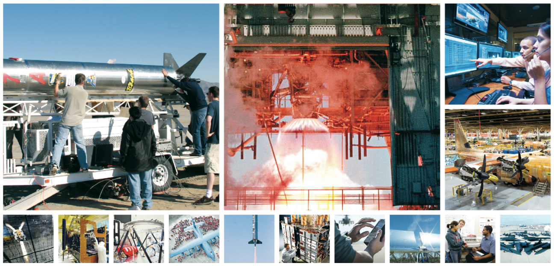

CULTIVATING ENGINEERING TALENT IN THE ANTELOPE VALLEY
Student Testimonial:
Marcea Ascencio
Kenneth W. Santarelli Ed.D., P.E.
Director, Antelope Valley Engineering Program

Slide 21

Program Uniqueness
Degree Completion for BS Electrical Engineering and BS Mechanical Engineering
Cohort Based
  Opportunity to engage in extensive engineering projects over the course of the program
  Encourages strong teamwork
  Able to emphasize leadership, enhance communication skills, & develop professionalism
Small Program
  Goal is to enroll 25 students in each discipline in the fall (50 students total)
  Providing unprecedented access to industry
  Program is very personal
  Graduation in 2.5 years guaranteed (Students must pass classes and stay in good standing

Slide 22
Program Uniqueness
  Program is highly structured
  Curriculum tailored for our region
  Experienced and highly capable academic and industry faculty
  Very ‘hands-on’ student experiences
Student Preparation
  Occurs at community college or at another university
  Experience indicates students enter program extremely well prepared

Slide 23
Schedule
Sunday | Monday | Tuesday | Wednesday | Thursday | Friday | Saturday
 | 9AM |  | 9AM |  | 9AM
 | 6PM+ |  | 6PM+ |  | 6PM+
Affords opportunity for students to engage with industry as interns during academic year as well as during summers

Slide 24

Accreditation
Western Association of Schools and Colleges (WASC)
Accreditation Board for Engineering and Technology (ABET)
  Both BS Mechanical and Electrical
  Engineering programs accreditation received in
  August
  Identified as BS Mechanical Engineering
  Extension Program and BS Electrical
  Engineering Extension Program on the
  ABET website

Slide 25
Student Success
Due in very large part to outstanding support from our community, education, and industry partners
Graduated two classes
  14 EE, 18 ME, 32 total
  One Magna Cum Laude, three Cum Laude
Cohort 3 to graduate in December
  4 EE, 10 ME, bring total graduates to 46
  One Magna Cum Laude, one Cum Laude
Cohorts 4 & 5 will add 25 ME & 13 EE Graduates

Slide 26
Student Success (Performance)
Graduates enjoy 100% employment rate
97% graduation rate
97% retention rate for program
Graduates compete well nationally
  We have one NSF Graduate Research Fellowship awarded
    Our graduate is conducting research at Stanford University
    The Fellowship will carry graduate through Ph.D.
  Students receive summer internships through Pathways program
    NASA Marshall Space Flight Center - Huntsville, AL
    US Navy Ordnance Disposal Technology Division – Maryland
    NAWCWD (China Lake)

Slide 27
Student Success (Internships)
Internships are paid
Regional Internships
  Northrop Grumman
  AFRL
  NASA Armstrong Flight Research Center
  NAWCWD (China Lake)
  Lockheed Martin (Flight Test)
  AF Test Wing
  BAE Systems
  The Spaceship Company
  Jacobs Engineering
  Crissair
  Pacific Seismic Products
  INCU, LLC
  TYBRIN

Slide 28
Student Success (Performance)
Students and graduates highly regarded by regional industry
  Approximately 80% of students have internships at any given time
  Many interns promoted to employee status while students
  Graduates performing well in industry
    Three graduates at one company reported to have received perfect performance reviews
    One of the three known to have been promoted and named lead engineer for the department less than two years after graduation
    Average starting salary for graduates approximately $70,000/year

Slide 29
In Conclusion
Outstanding unique program design delivered by CSULB College of Engineering
Only one issue to overcome
  Enrollments have not exceeded 60% of that required for self sustaining
  Revenue short fall for existing student base may reach $250,000 by December 2017
    Solutions being pursued to mitigate revenue shortfall
    Marketing expanded beyond Southern California to attract more students

Slide 30

QUESTIONS?
Degree Completion Program in
Mechanical & Electrical Engineering
Offered in the Antelope Valley
http://www.ccpe.csulb.edu/engineering
Notes:
30

Slide 31
4th Annual STEMposium
8:40—9:10 am-----Director’s Update---Christos Valiotis, AVC
9:10---9:30 am-----CSULB AV Engineering Program Update---Ken Santarelli, CSULB
9:30---9:55 am-----California STEM Learning Network- AV-East Kern Update
Kriss Vanderhyde, Ed. Outreach Manager, Air Force Research Lab
Diane Walker, Coordinator of College & Career Readiness, AVUHSD
9:55---10:10 am-----Break
10:10---10:40 am-----Science Education for 21st Century Skills---Wes Farno, 29:11 Strategies
10:45---11:15 am-----NASA Undergraduate Research Initiative, Al Bowers, Chief Scientist, NASA Armstrong

Slide 32
Antelope Valley East Kern STEM Network
4th Annual AV STEMposium
6 November 2015
Hellenic Center - Lancaster, CA

Slide 33
Antelope Valley East Kern STEM Net
Vision and Mission
Accepted as a CSLN Regional Network in January 2015 with 501(c )(3) sponsorship through the AERO Institute.
Vision:
All students in the Antelope Valley East Kern STEM Network will demonstrate the STEM knowledge and skills necessary for success in education, work, and their daily lives.
Mission:
To grow and maintain a diverse, progressive, and innovative STEM workforce within the greater Antelope Valley East Kern STEM Network through education programs and strong, dynamic community partnerships, and to establish a unified voice for STEM policy and activities throughout the region.

Slide 34
Antelope Valley East Kern STEM Net
Goals and Objectives
1. Increase the number of STEM graduates to meet current and future regional workforce and economic development needs within the Antelope Valley East Kern STEM Network.
  Objective: Increase attainment of STEM-related credentials, degrees and careers
2. Build partnerships to connect education, business and community assets to increase efficiency, innovation, scale and sustainability of quality STEM teaching and learning within the Antelope Valley East Kern STEM Network.
  Objective: Develop and maintain a continuum of work-based learning experiences for preK-16 students
  Objective: Leverage and coordinate regional resources, facilities, and tools needed to enhance preK-16 education of students, staff, and instructors (including formal and informal educators)
3. Strengthen quality of and expand access to STEM education across the preK-16 formal and informal educational institutions in the Antelope Valley East Kern STEM Network.
  Objective: Increase the number of highly effective preK-16 STEM educators
  Objective: Promote college and career readiness for all Antelope Valley East Kern STEM Network students
STUDENTS:
PARTNERS:
EDUCATORS:

Slide 35
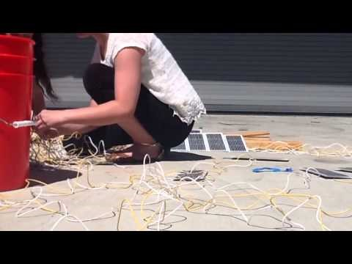
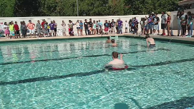
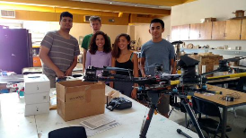
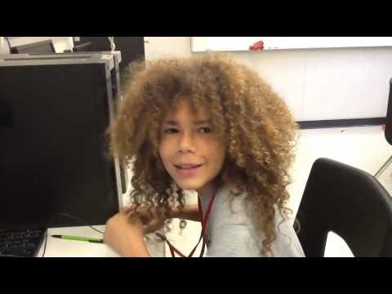
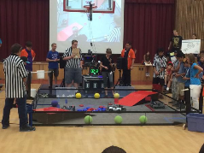
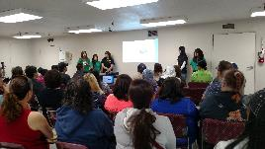
What We Do
Promote high-quality STEM teaching and learning throughout the greater Antelope Valley East Kern region
Courses and pathways
Professional learning for instructors
Work-based learning (job shadowing, internships, teacher externships)
Activities (co- and extra-curricular, in-school, and out-of-school time)
Industry/community tours
STEMPosium to engage and inform stakeholders

Slide 36















Partners and Affiliates
  Air Force Research Lab – Edwards Air Force Base
  Antelope Valley College/AVC Foundation
  AERO Institute
  California State University Long Beach – Antelope Valley Engineering Program
  Cerro Coso Community College
  Edwards Air Force Base 412th Test Wing
  Greater Antelope Valley Economic Alliance
  Keppel Union School District – Daisy Gibson School
  Los Angeles County Office of Education
  Mojave Unified School District
  Muroc Joint Unified School District
  Paraclete High School
  Southern Kern Unified School District
  Tehachapi Unified School District
  The Palmdale Aerospace Academy
  Westside Union School District

Slide 37

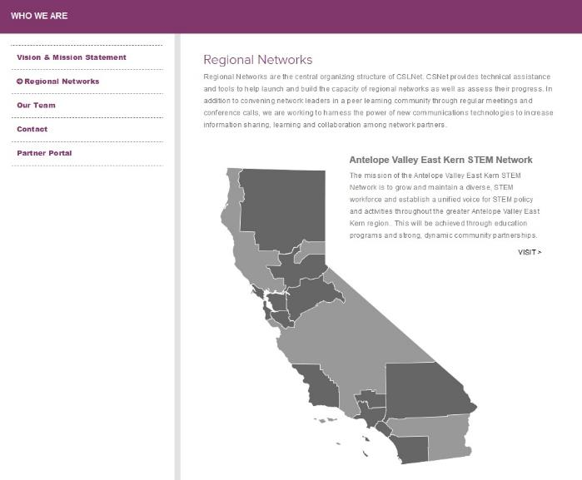
Vision
All students in California will graduate with the STEM knowledge and skills required for success in education, work and their daily lives.
Mission
Prepare the nation’s most STEM-capable graduates by coordinating and activating a multi-sector statewide network representing all STEM stakeholders.
CSLNet supports Regional STEM Networks throughout the state of California. These organizations actively build partnerships with PK-12, higher education, and business and industry to address regional needs in STEM teaching and learning through the implementation of innovative and effective strategies.
These strategies will build the capacity to capture learning at the local level and translate into a statewide STEM agenda and solution.

Slide 38
What We Have Done
STEM Tours
AV Wind Challenge
AV STEM Expo
Monthly STEM Network meetings @ different sites throughout the region
SMAP – Senior Math Acceleration Program
STEM Conference for Girls
Summer activities
Planning - Unmanned Aerial Vehicle Challenge

Slide 39
Looking Forward
NMSI and Military Children Initiative
High Desert University
On-going funding for STEMposium
STEM Conference for Girls
Summer STEM Camps
Science Olympiad

Slide 40
How do I get Involved?
Come to a Meeting:
  Next meeting is 12th November, 3:30pm, AVUHSD Palmdale Conference Center (2nd Thursday, rotating locations)
Send a “Letter of Support” letting us know your organization supports STEM and would like to join us in supporting network goals and objectives.
Contact one of the Steering Committee Members (wearing “Ask Me About” buttons):
  Randy Scott – AV Board of Trade – rscott@antelecom.net
  Shaun Smith – AERO Institute - shaun.smith@nasa.gov
  Les Uhazy – Antelope Valley College - luhazy@avc.edu
  Kriss Vanderhyde – Air Force Research Laboratory – kriss.vanderhyde@us.af.mil
  Diane Walker – AV Union High School District - DWalker@avhsd.org
  Gary Widdison – LA County Office of Education - Widdison_Gary@lacoe.edu

Slide 41
Rocket Lab ENSPIRE Program
Looking to fund Proposals for Next-Generation STEM Innovation from:
  Students
  Teachers
  Schools
  Districts
Contact: Mr. Kriss Vander Hyde
  kriss.vanderhyde@us.af.mil or 661-275-5429

Slide 42
Knight High School Camps
Knight High School Gateway Camp 2015
Knight High School-Summ3r Camp 2015

Slide 43
4th Annual AV STEMposium
8:40—9:10 am-----Director’s Update---Christos Valiotis, AVC
9:10---9:30 am-----CSULB AV Engineering Program Update---Ken Santarelli, CSULB
9:30---9:55 am-----California STEM Learning Network- AV-East Kern Update
Kriss Vanderhyde, Ed. Outreach Manager, Air Force Research Lab
Diane Walker, Coordinator of College & Career Readiness, AVUHSD
9:55---10:10 am-----Break
10:10---10:40 am-----Science Education for 21st Century Skills---Wes Farno, 29:11 Strategies
10:45---11:15 am-----NASA Undergraduate Research Initiative, Al Bowers, Chief Scientist, NASA Armstrong
Notes:
Load Wes Farno’s Powerpoint separately…Read Wes’ bio and introduce him.

Slide 44
4th Annual AV STEMposium
8:40—9:10 am-----Director’s Update---Christos Valiotis, AVC
9:10---9:30 am-----CSULB AV Engineering Program Update---Ken Santarelli, CSULB
9:30---9:55 am-----California STEM Learning Network- AV-East Kern Update
Kriss Vanderhyde, Ed. Outreach Manager, Air Force Research Lab
Diane Walker, Coordinator of College & Career Readiness, AVUHSD
9:55---10:10 am-----Break
10:10---10:40 am-----Science Education for 21st Century Skills---Wes Farno, 29:11 Strategies
10:45---11:15 am-----NASA Undergraduate Research Initiative - Al Bowers, Chief Scientist, NASA Armstrong Research Center
Notes:
Load Al’s Powerpoint separately…Read Al’s bio and introduce him…

Slide 45
4th Annual AV STEMposium
11:15---12:15 pm------K-12 STEM Team Presentations
  11:15-11:25------Knight High—James Stockdale
  11:25-11:35------Tehachapi High School--Danielle Evansic
  11:35-11:45------The Palmdale Aerospace Academy—Matt Winheim
  11:45-11:55------Palmdale High—Antek Ignatowitz
  11:55-12:05------SOAR High School—Rachel Thibault
Notes:
Presenters should stand by to get on the podium and start their presentation immediately after the preceding presentation.

Slide 46
4th Annual AV STEMposium
11:15---12:15 pm------K-12 STEM Team Presentations
  11:15-11:25------Knight High—James Stockdale
  11:25-11:35------Tehachapi High School--Danielle Evansic
  11:35-11:45------The Palmdale Aerospace Academy—Matt Winheim
  11:45-11:55------Palmdale High—Antek Ignatowitz
  11:55-12:05------SOAR High School—Rachel Thibault
Notes:
Announce that: Presenters should stand by to get on the podium and start their presentation immediately after the preceding presentation.

Slide 47
4th Annual AV STEMposium
12:15---Lunch
12:30---1:30 pm-----Keynote, Dr. Daniel Manson, Cal Poly Pomona
1:30---2:00 pm------Closing Remarks-Feedback-Evaluation
Notes:
Lunch protocol: 1) VIP table (Dr. Manson’s table) starts lunch first. 2) Lunch continues row by row starting with row closer to the stage. Student assistants will be there to direct flow. Ask participants to follow their directions.
3) Around 12:30 – 12:40 we will announce Dr. Manson and read his bio before calling him on the stage.
Request that participants keep the plate noise as low as possible while finish eating.

